Slide 1



2023
INTRODUCTION
Shandong Xinya GreenPower Fuel Injection System Co.,Ltd International Trade Department

Slide 2
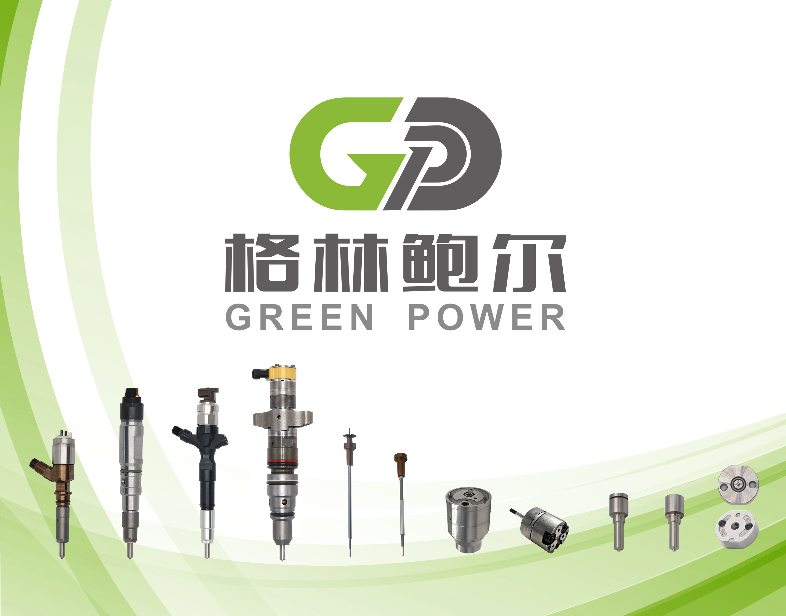
PRENENTATION
Shandong Xinya Green Power Fuel Injection System Co., Ltd.,is located in has the reputation of liaocheng city in shandong province,our branch is located in Wuxi， was founded in March 2017, the registered capital of 186 million yuan. The specialty is engaged in the research and development of diesel engine high pressure common rail fuel injection system products manufacturing. With high pressure common rail system of the communist party of China rail injector always become the forerunner and the main direction, the construction of "annual output of 1 million high pressure common rail injector assembly car parts project", the project is listed as a key project of shandong kinetic energy conversion between the old and the new.
Purchase, such as Germany, Switzerland and Italy industry 80 sets of advanced processing and testing equipment, and form a complete set of domestic main equipment 280 units (sets), equipment worth $450 million.
Until now, has 550 research and development production of common rail injector assembly model, 250 type valve components, nozzle 300 models, basically covering the market demand of common and special specifications, especially high, refined, thin and hard to specifications, development and production ability. The quality of the products meet or exceed similar foreign products, fully able to meet the demand of the host and maintenance. In the same industry in a leading position in domestic.
Company is the national high-tech enterprises, provincial top 100 private enterprise innovation potential, 2021 annual provincial new kinetic energy fund project enterprise; Obtains the title of national environmental protection and energy saving products. With shandong traffic institute and qilu industrial university built university-enterprise cooperation relationship. Passed the ISO14001 environment system certification, IATF16949 quality management system certification, dun and bradstreet certification.
Notes:
更多模板下载地址：http://www.pptvzaixian.com/shop/view28111.html（复制链接到浏览器打开）

Slide 3
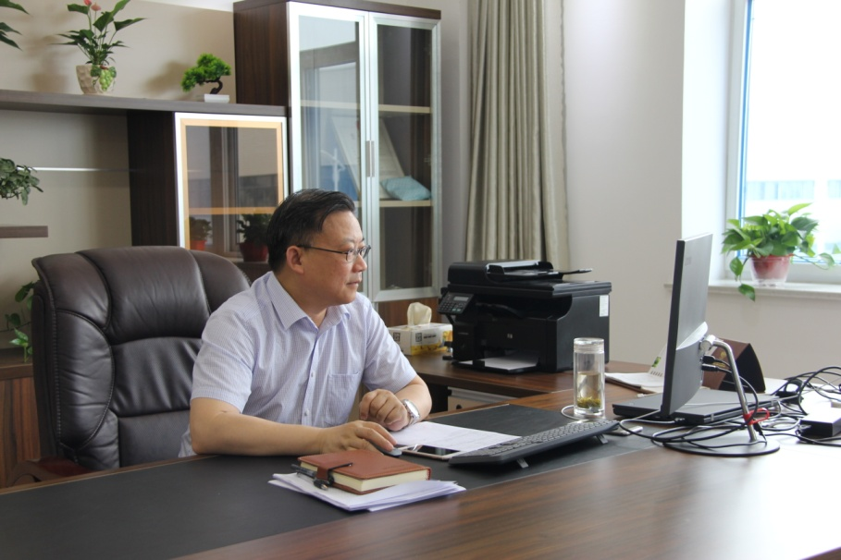
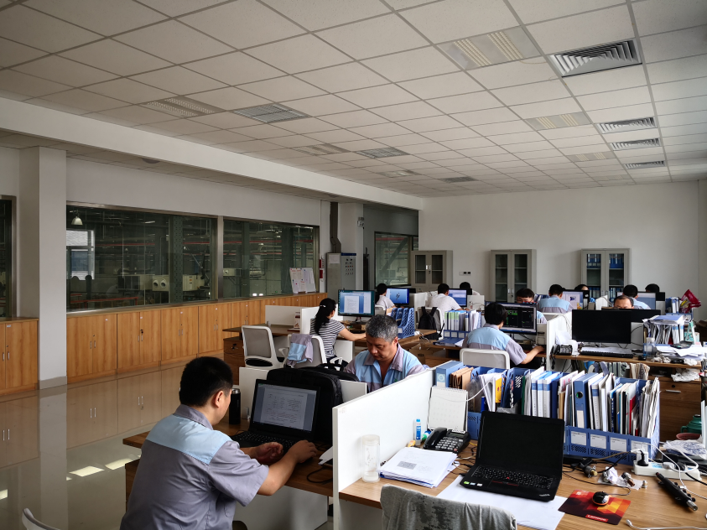
Technical Team
Leader: Zhuang Furu
· more than 50 technicians
Domestic common rail standard setter focusing on the field more than 30 years
5%
Three Deputy General Managers: focusing on the field over 10 years, having profound work experience and in charge of technical development, production and assembly respectively.
Production Director: focusing on the field for 20 years, the former chief engineer in Kangda.
Chief processing engineer: focusing on the field for 15 years, the former chief processing engineer in Xinfeng.
Production development manager: focusing on the field about ten years, the former director for injector development in Wuxi Injector Pump and Nozzle Research Institute.
Purchasing manager & engineering and equipment administrator: focusing on the field for 30 years, the former chief engineer in Yancheng machine tool plant.
10%
20%

Slide 4
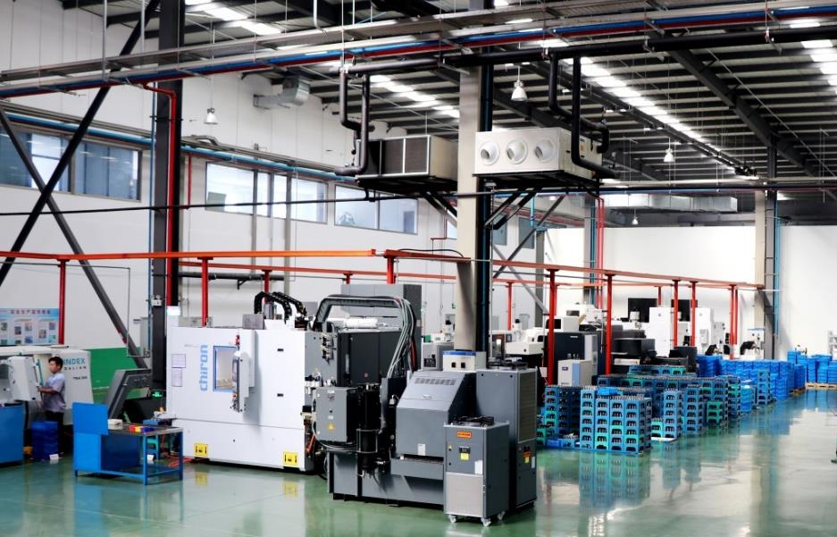
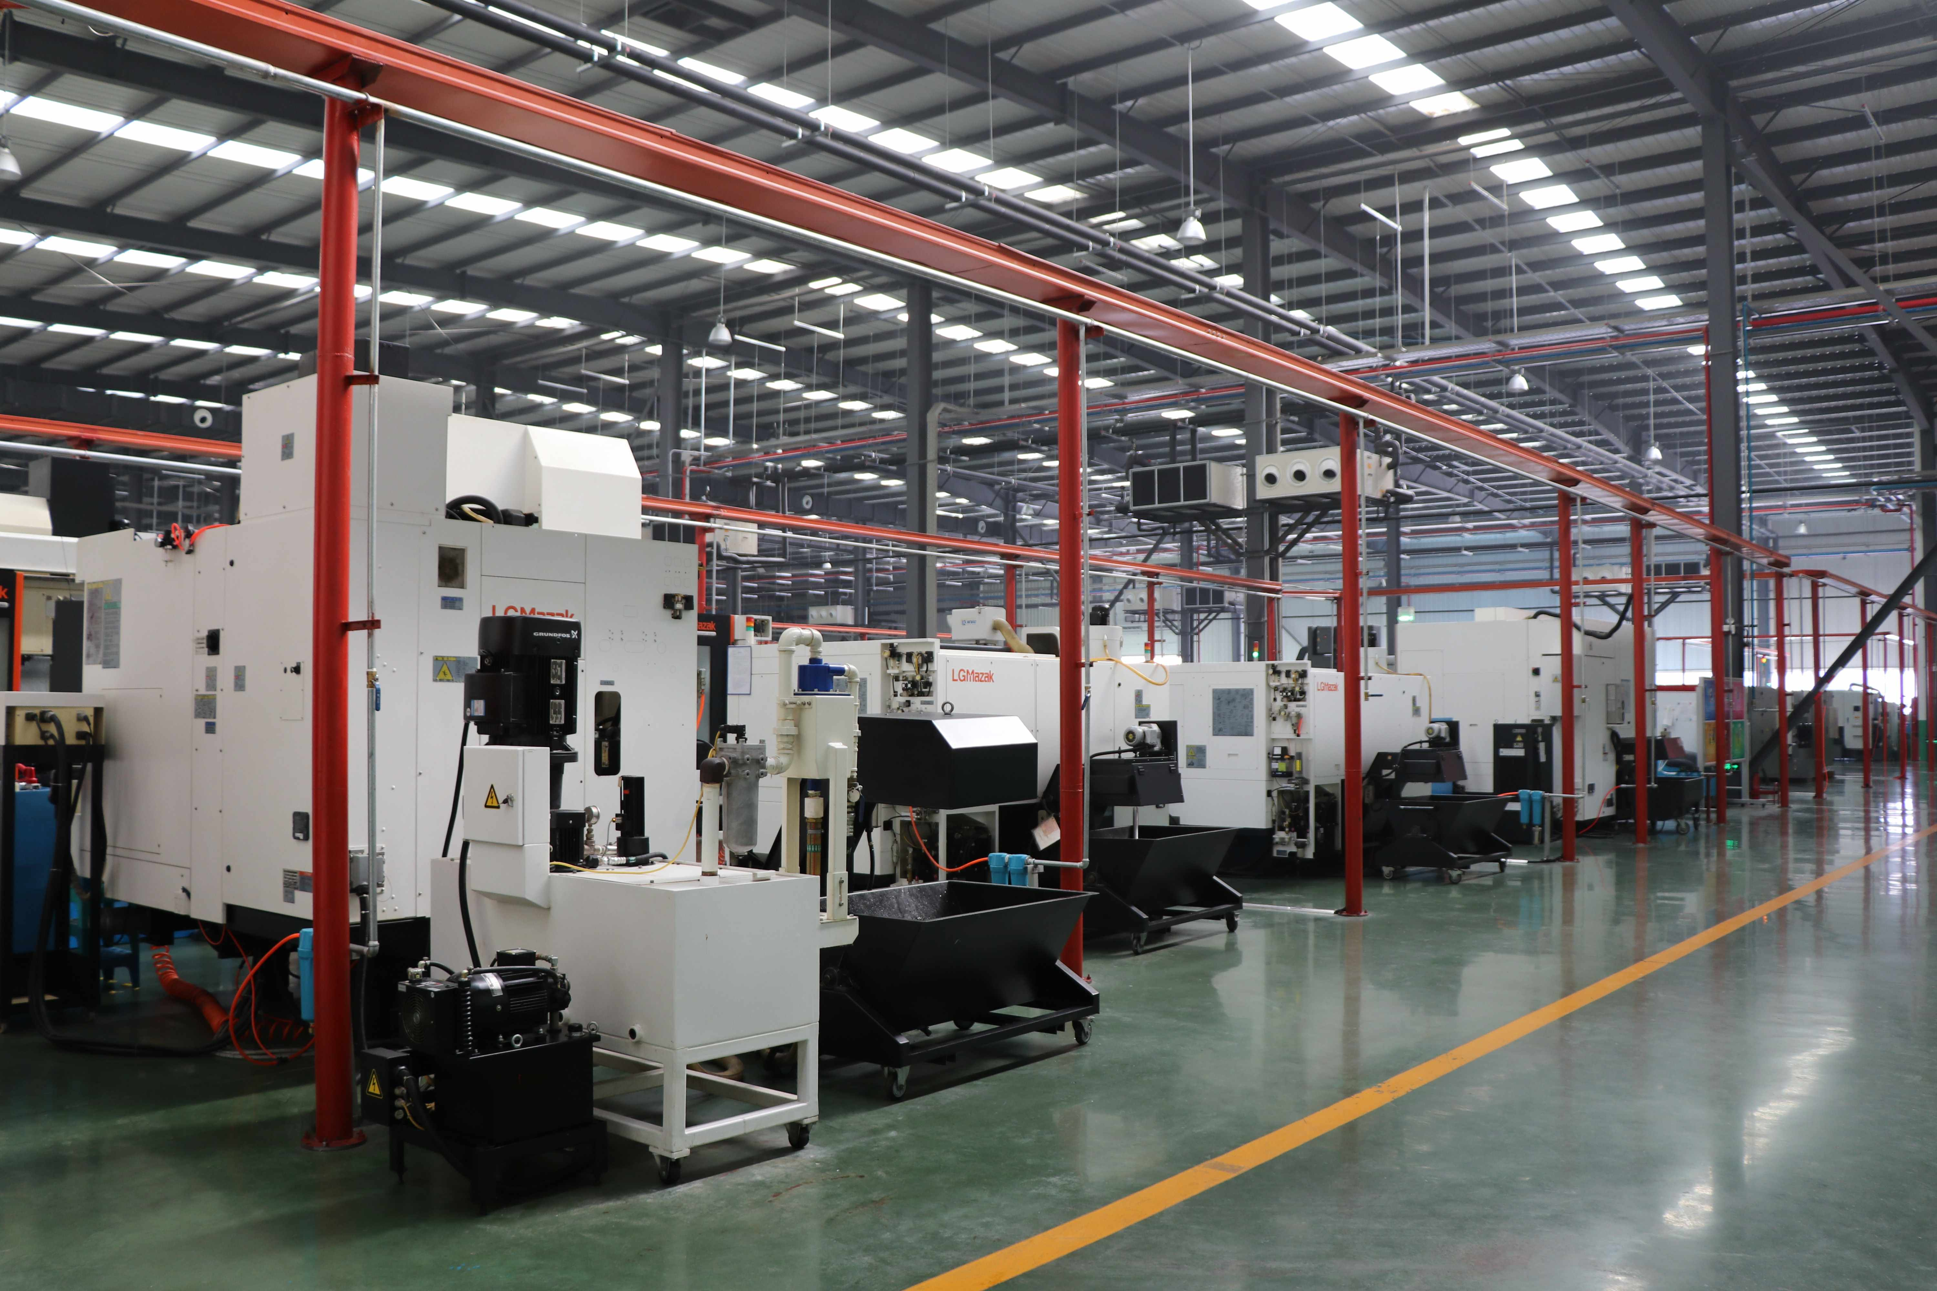
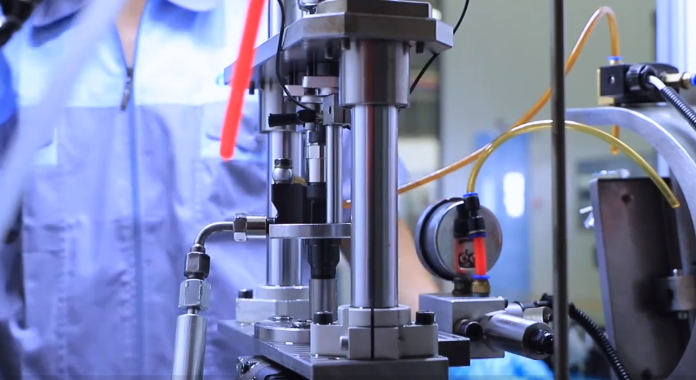
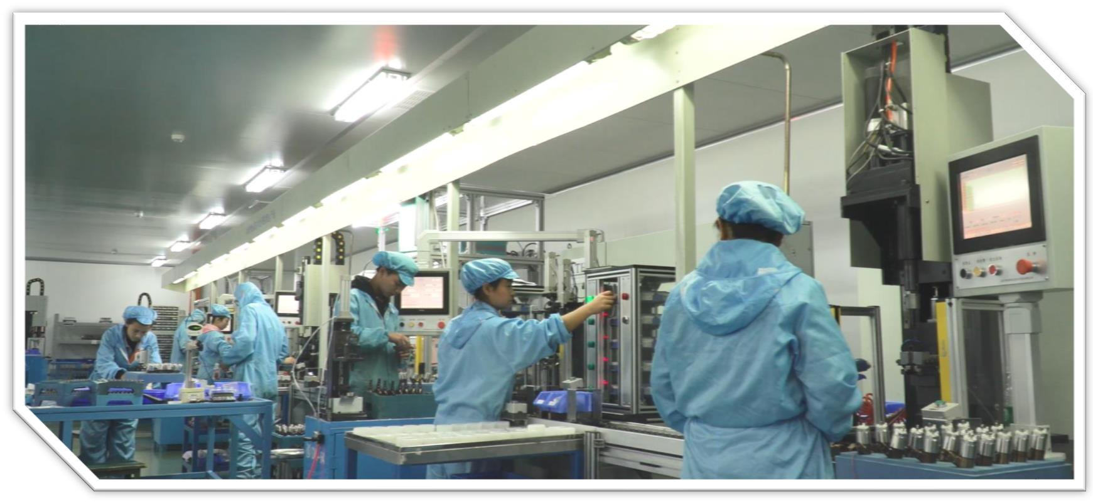
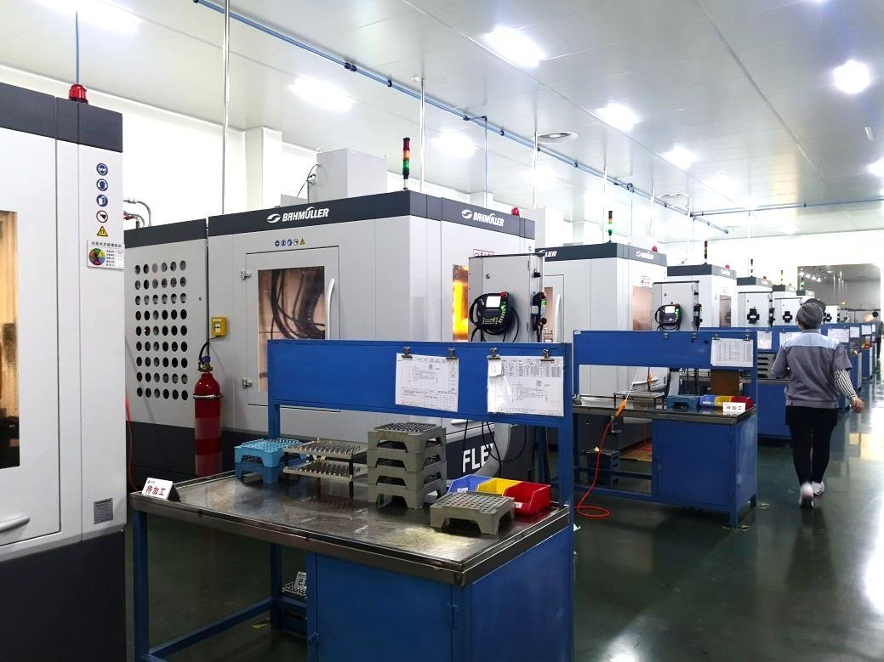
Production Equipment
·The company has assets of CNY 500 million and more than 350 main production equipment, of which is equipped with more than 60 sophisticated equipment from Germany, Switzerland, the United States, Japan and other developed countries.
The company has two common rail nozzle production lines, three automatic production lines for valves, one automatic assembly line, one performance testing line, one testing room, one emission laboratory, cleaning machines and other ancillary equipment, and also including one 10,000 grade ECU purification shop, one semi-finished valve and nozzle valve processing shop and a complete set of heat treatment equipment.
5%
10%
20%
At present the annual production capacity of three hundred thousand high-pressure common rail injectors, 1.5 million pairs of nozzle and 1.5 million valve assemblies has been formed, ranking first in the domestic industry in scale.

Slide 5
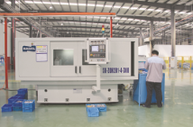
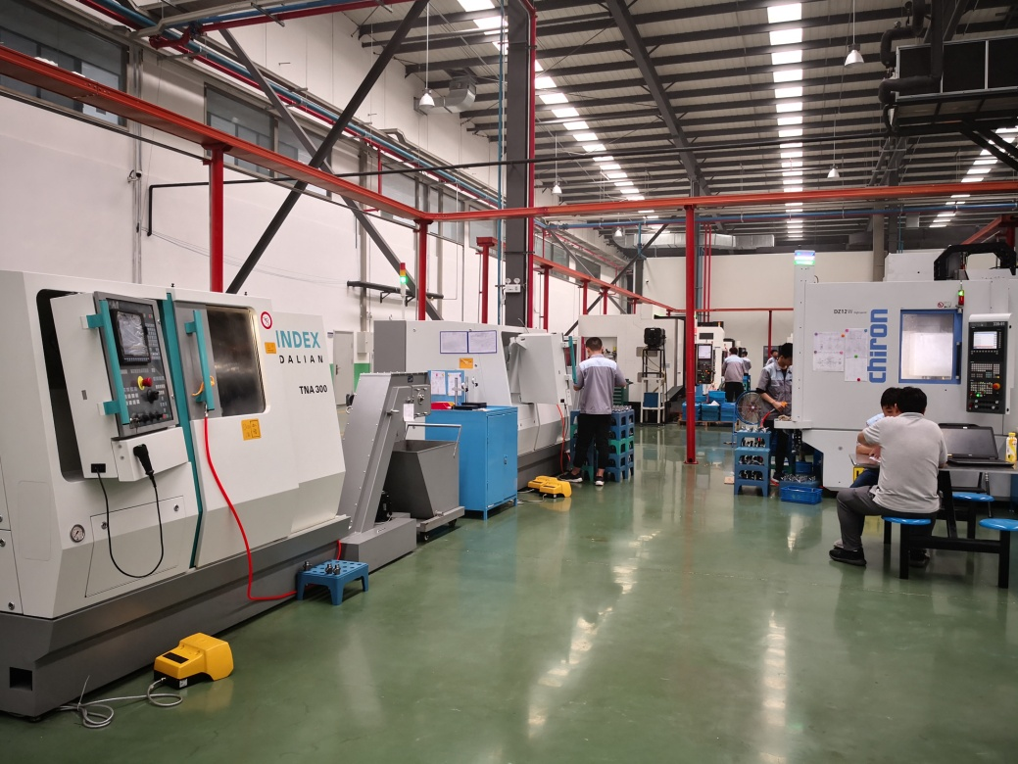

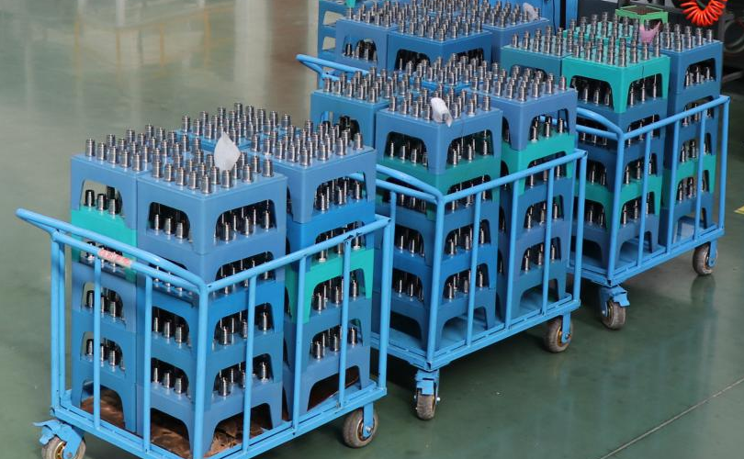
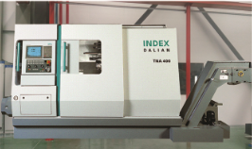

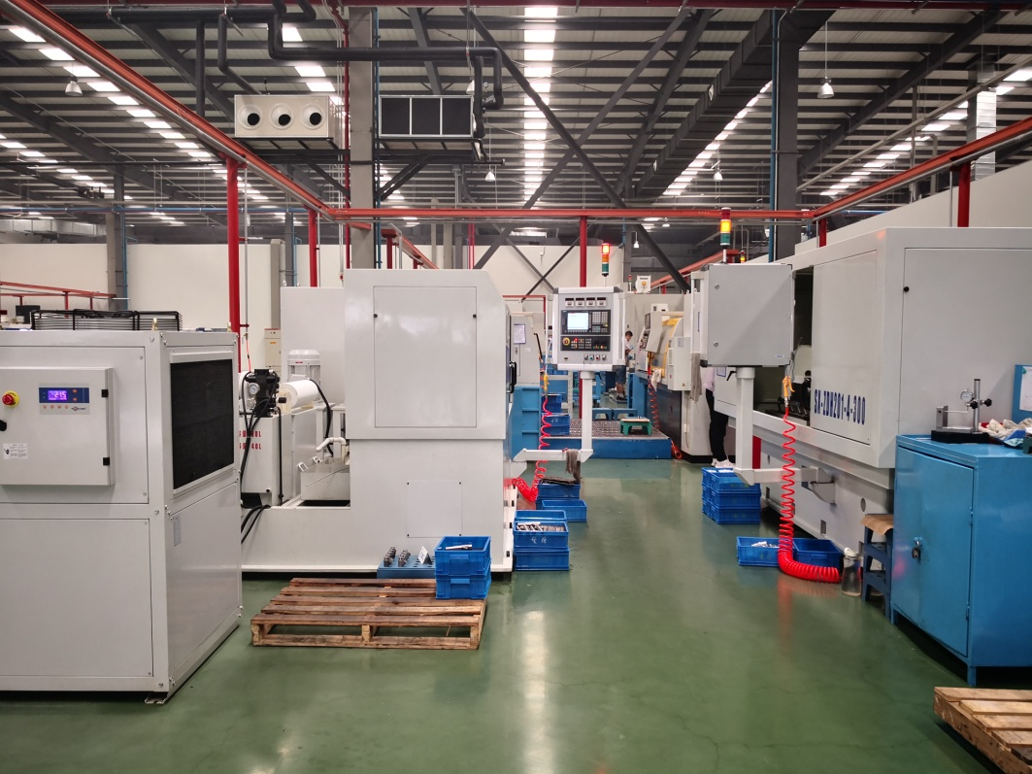
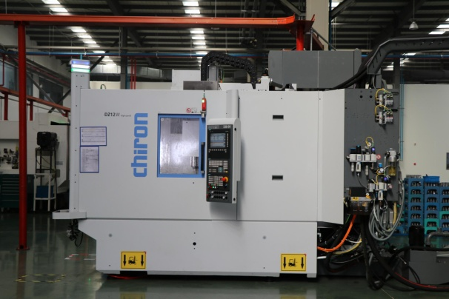

Production Equipment
Injector
Four-axis gun drilling machine
Turning center
Five-axis machining center

Slide 6
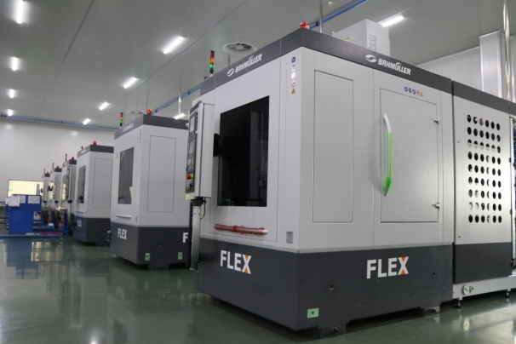
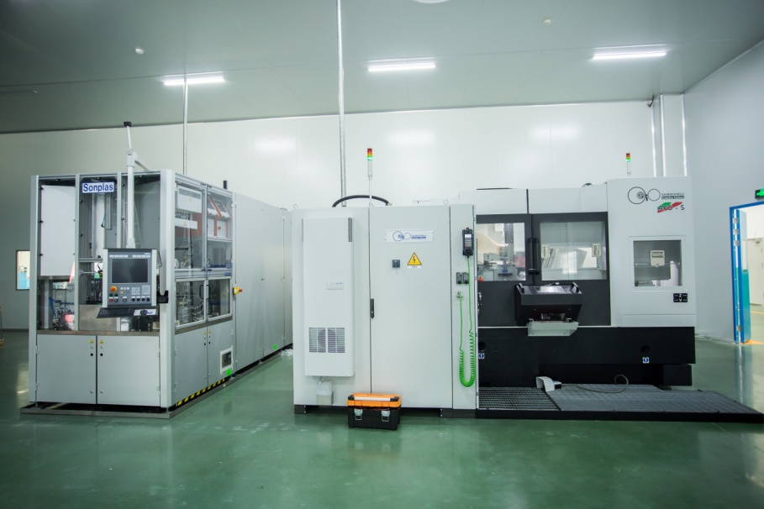

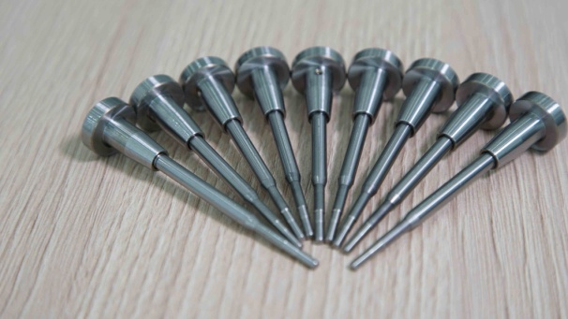
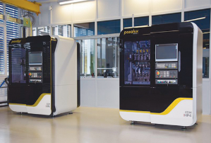

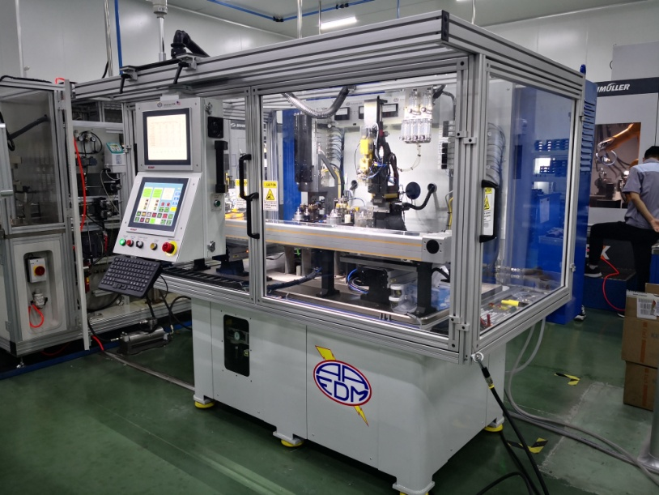
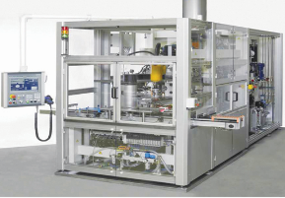

Production Equipment
Valve
High precision grinding machine
EDM hole drilling machine
Eight-position hydraulic abrasive machine

Slide 7
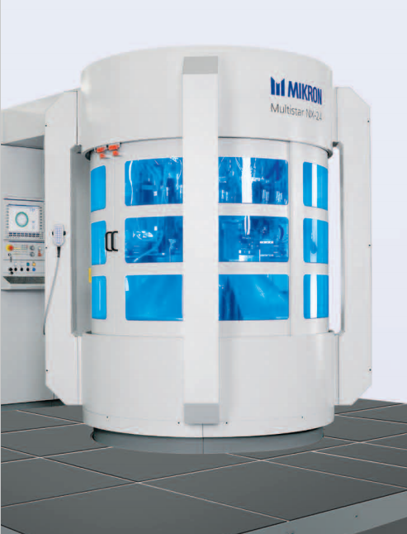
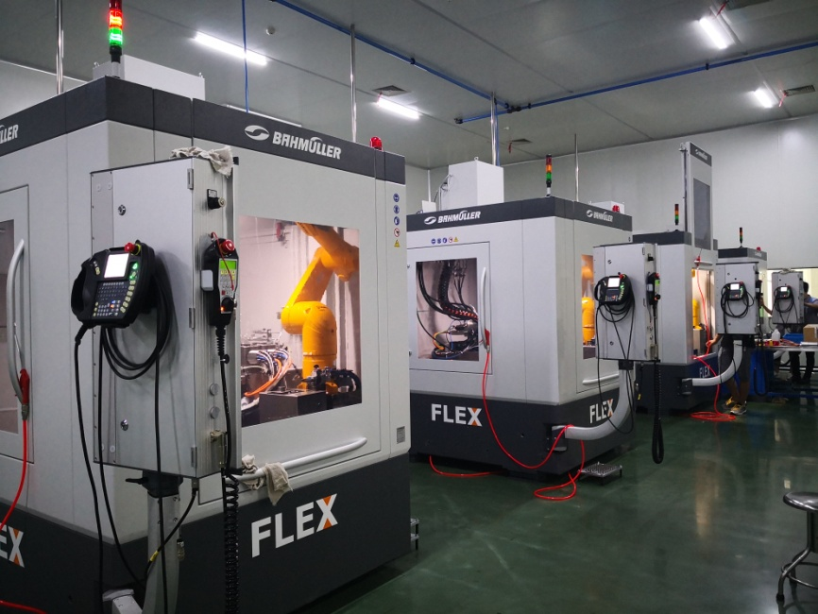

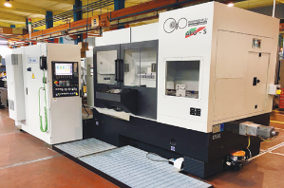


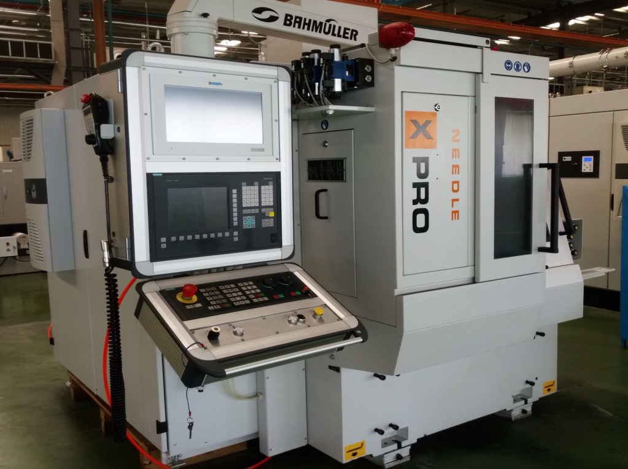
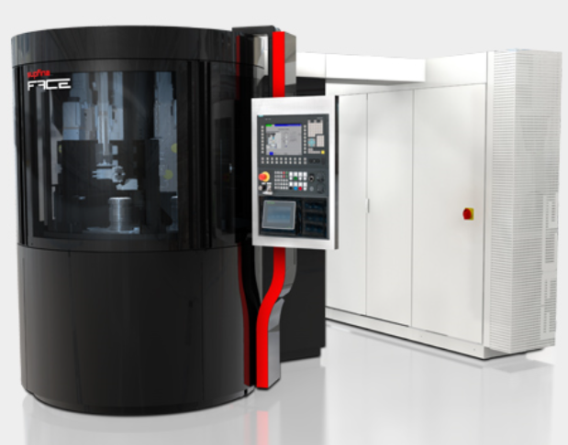

Production Equipment
From semi-finished products
Nozzle
High precision grinding machine
Ultra fine surface grinding machine

Slide 8
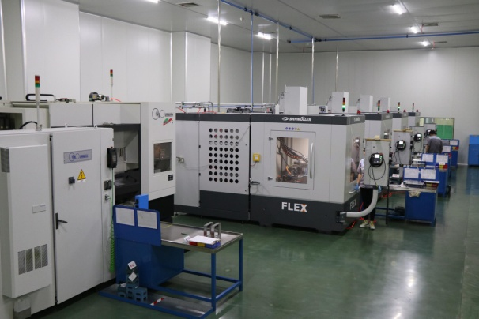
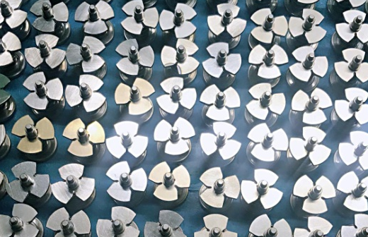
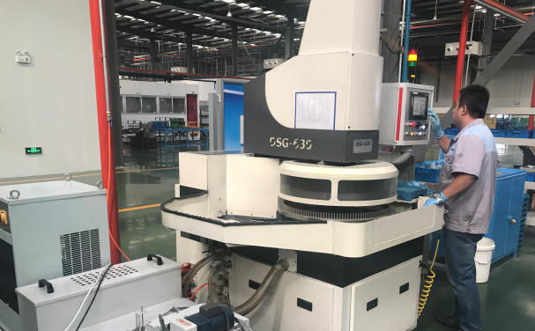
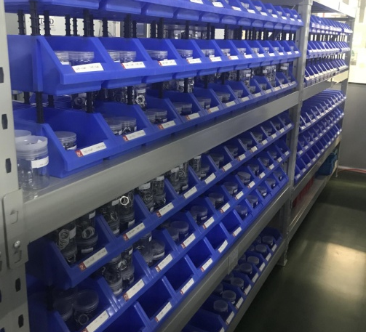
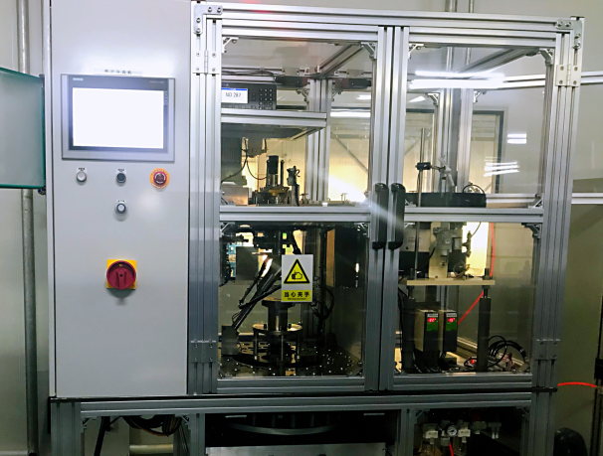
Production Equipment
Armature group assembly
Shim
Shims
1. The parallelism1u；
2. The classifying precision 0.002mm.
The classifying precision of shims on the market is just 0.01-0.02mm now.

Slide 9
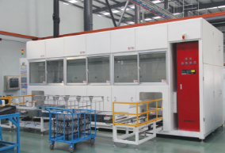
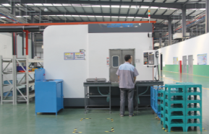
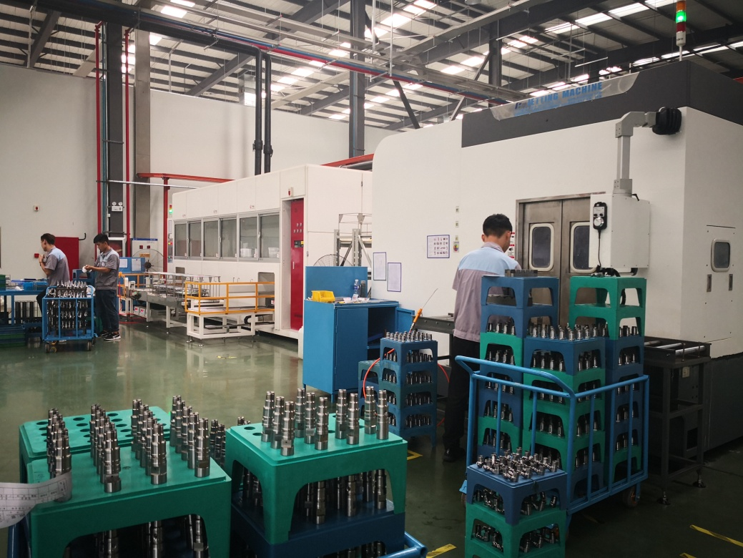
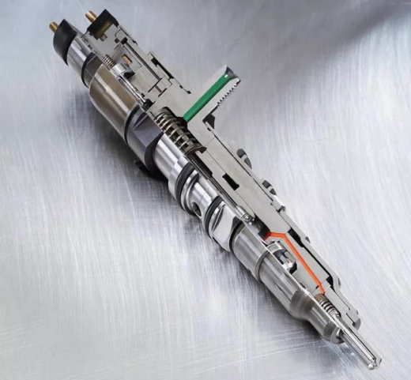
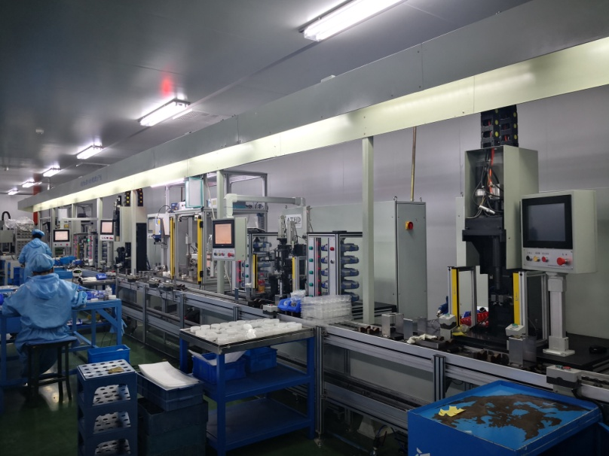
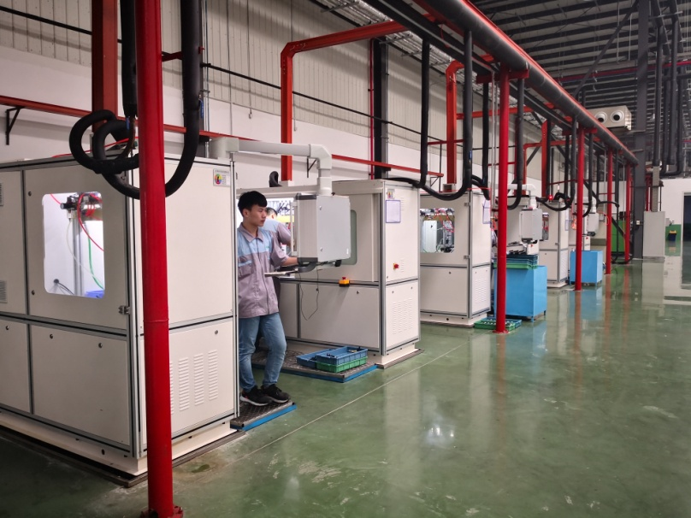
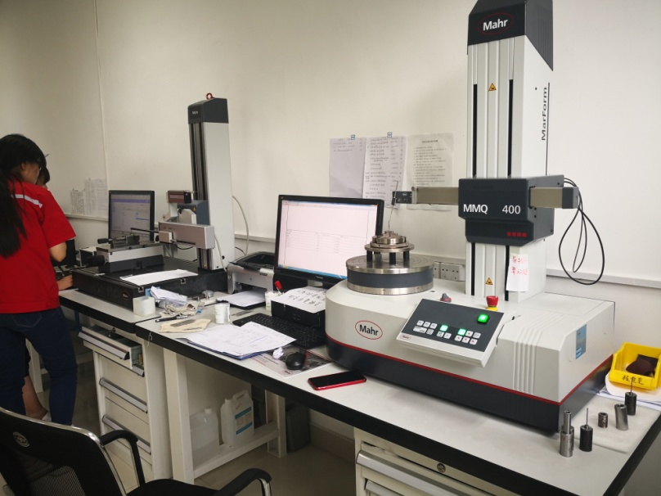
Production Equipment
Quality control
Fully automatic four trough hydrocarbon vacuum cleaning machine
500bar high pressure cleaning machine
The cleanliness of the parts can reach AA level
Class 10,000 purification assembly shop
EFS EMI3 automatic test line, France
100% full test before sales

Slide 10
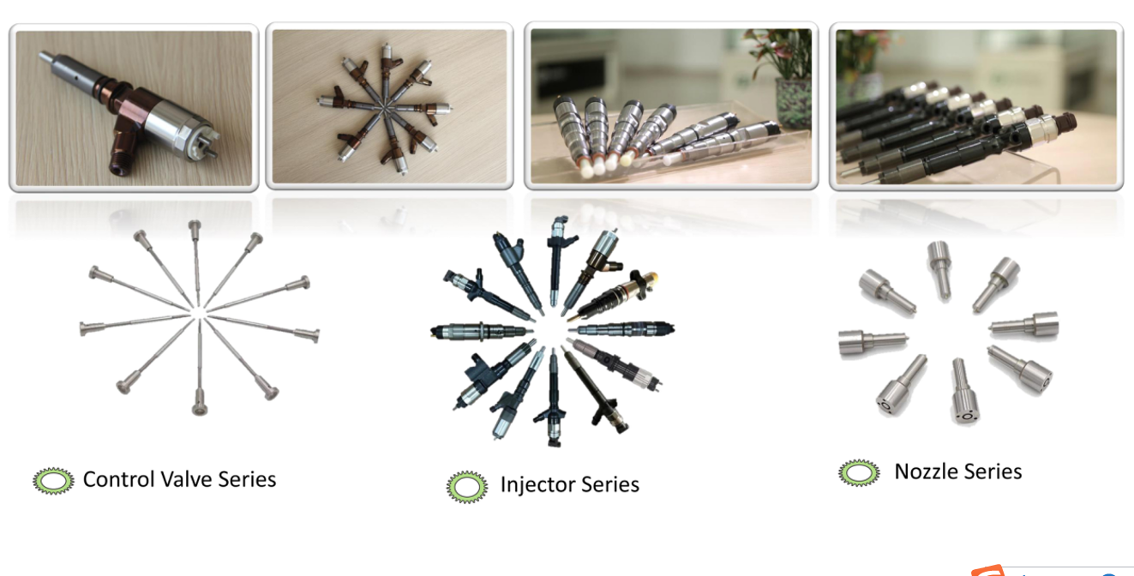
Products
· At present products in the company mainly cover high-pressure common rail injectors for Bosch, Denso, CAT series and related components, as well as parts of Delphi injector control valves.
5%
10%
20%

Slide 11

BOSCH SERIES
· Bosch series of main products: high-pressure common rail injector, valve, nozzle and repair kit.
Bosch Injectors
Series 110 and series 120 are now on the market, which are mainly used for Commins engines, heavy trucks, light trucks and passenger vehicles in Europe and the United States.
Appearance, structure, performance and other aspects of Bosch injectors in the company are identical to the original manufacturer’s, which can directly replace the original machine injectors.
The main markets:
Europe, North America, the Middle East, South Africa

Slide 12
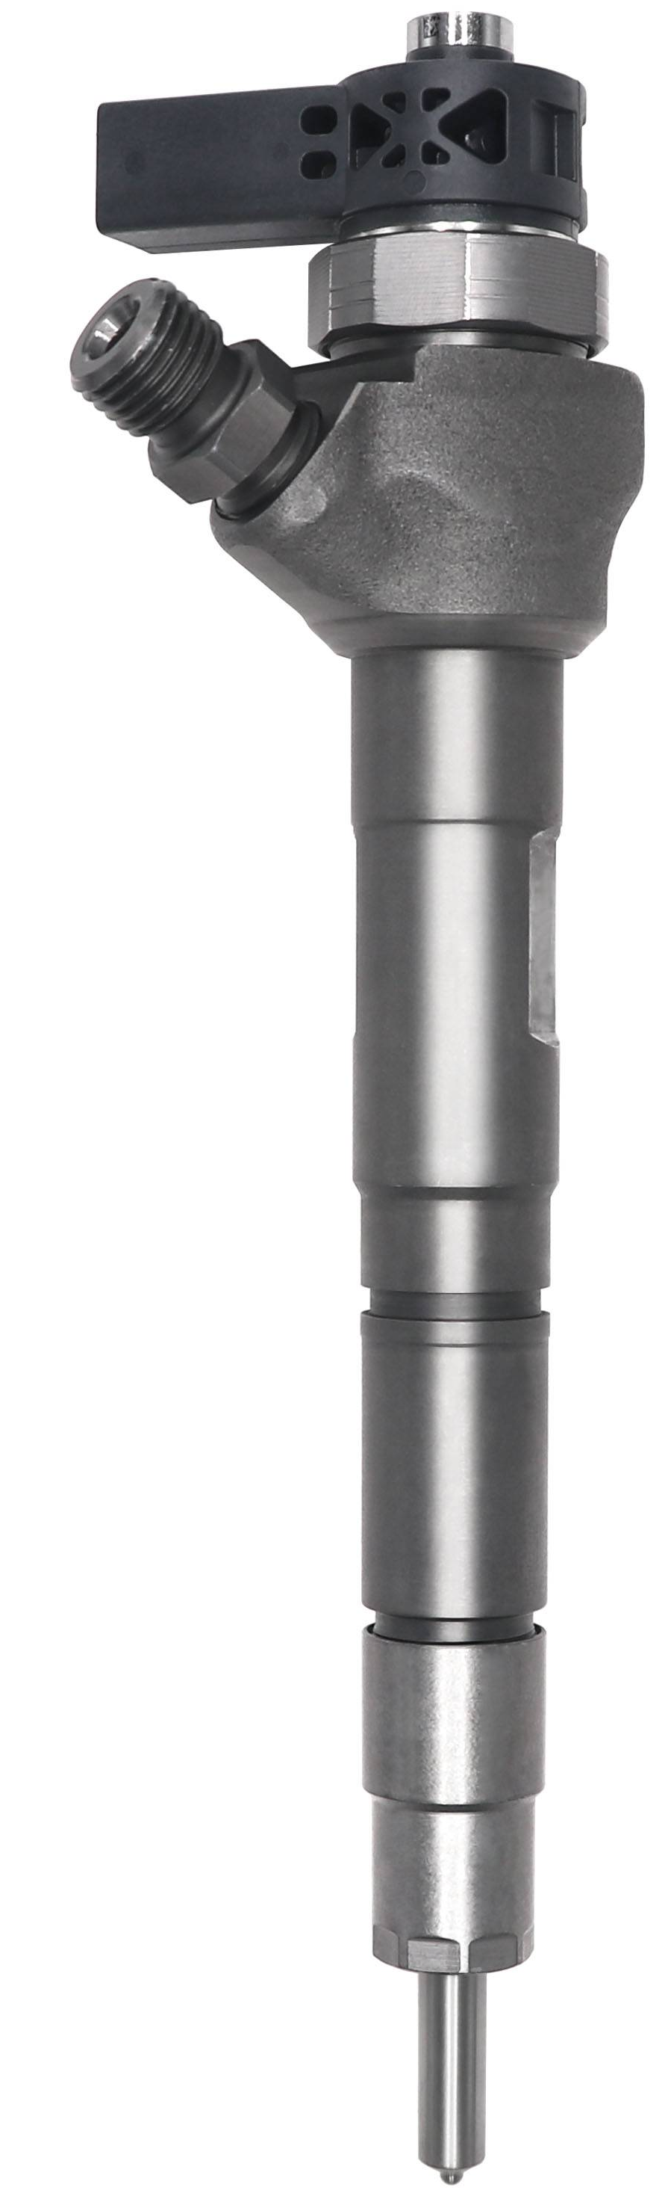
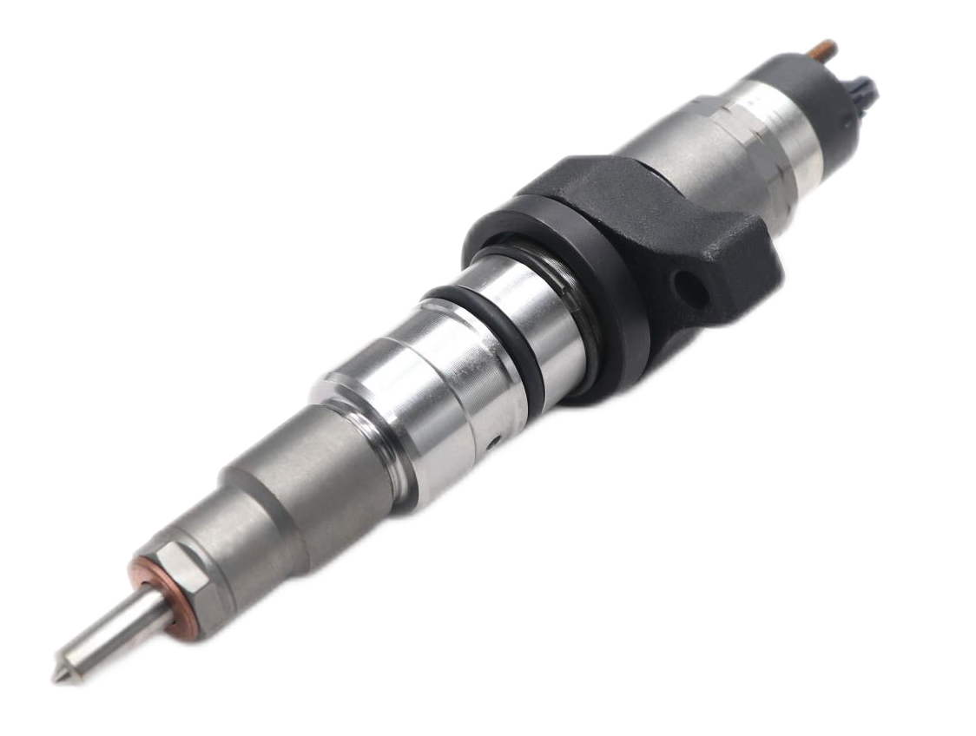
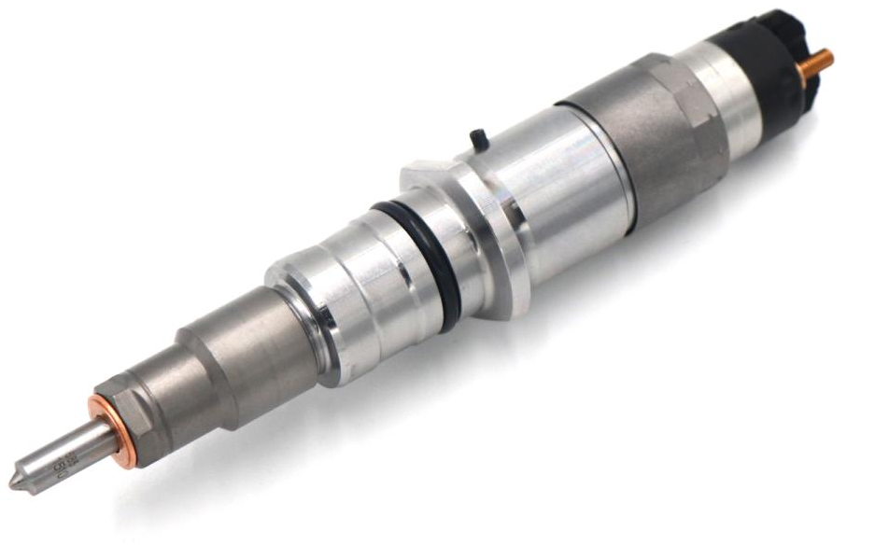
BOSCH SERIES
Bosch injectors best-selling models
0 445 120 007
0 445 110 647
0 445 120 217/218
0 445 120 059/231
Heavy trucks
Passenger vehicles
Heavy trucks
0 445 120 236
CUMMINS
IVECO EURO CARGO
DAF LF 5.9
VW Amarok 2.0/Caddy/Golf/Audi/SEAT/SKODA 2.0
Engineering machinery
MAN TRUCK
TGA/TGS/TGX
KOMATSU
PC200-8/PC300-8
Best-selling markets:
Europe, North America, South America
Best-selling markets:
Europe
Best-selling markets:
North America, Africa, South America
Best-selling markets:
Europe, the United States

Slide 13
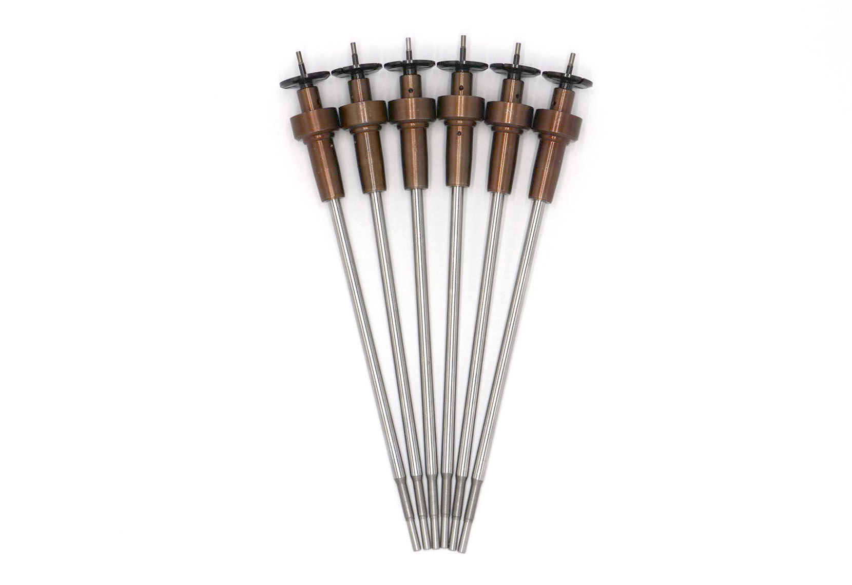
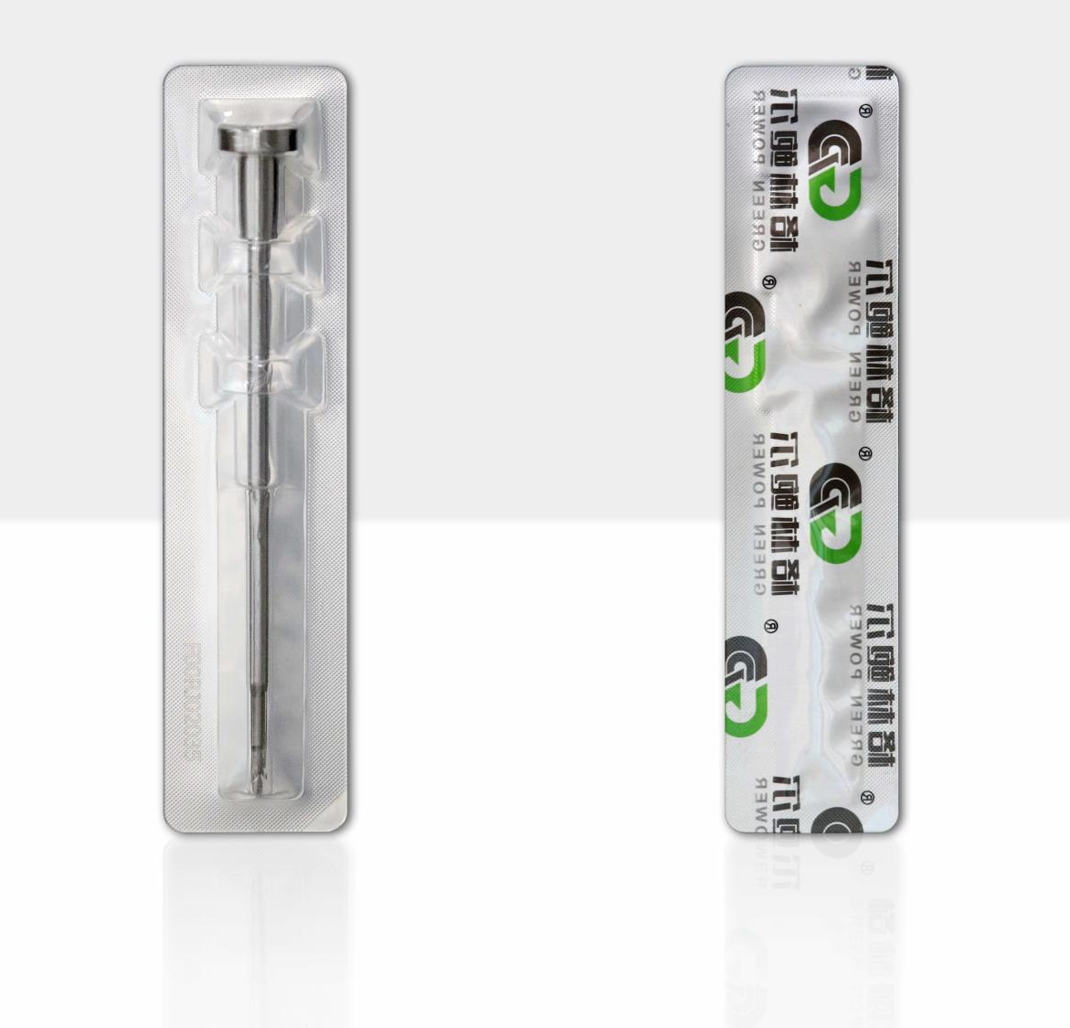
BOSCH SERIES
Bosch Valve
Valves for series 110 and series 120 injectors is now on the market.
In 2021, the company strategically developed 110 series of European Ⅴ valve assemblies, which quickly became best-selling products, with an annual turnover of more than CNY 200,000.
The main markets:
Valve —— the Middle East, North Africa, Russia
Valve assembly —— Europe, America, the Middle East

Slide 14
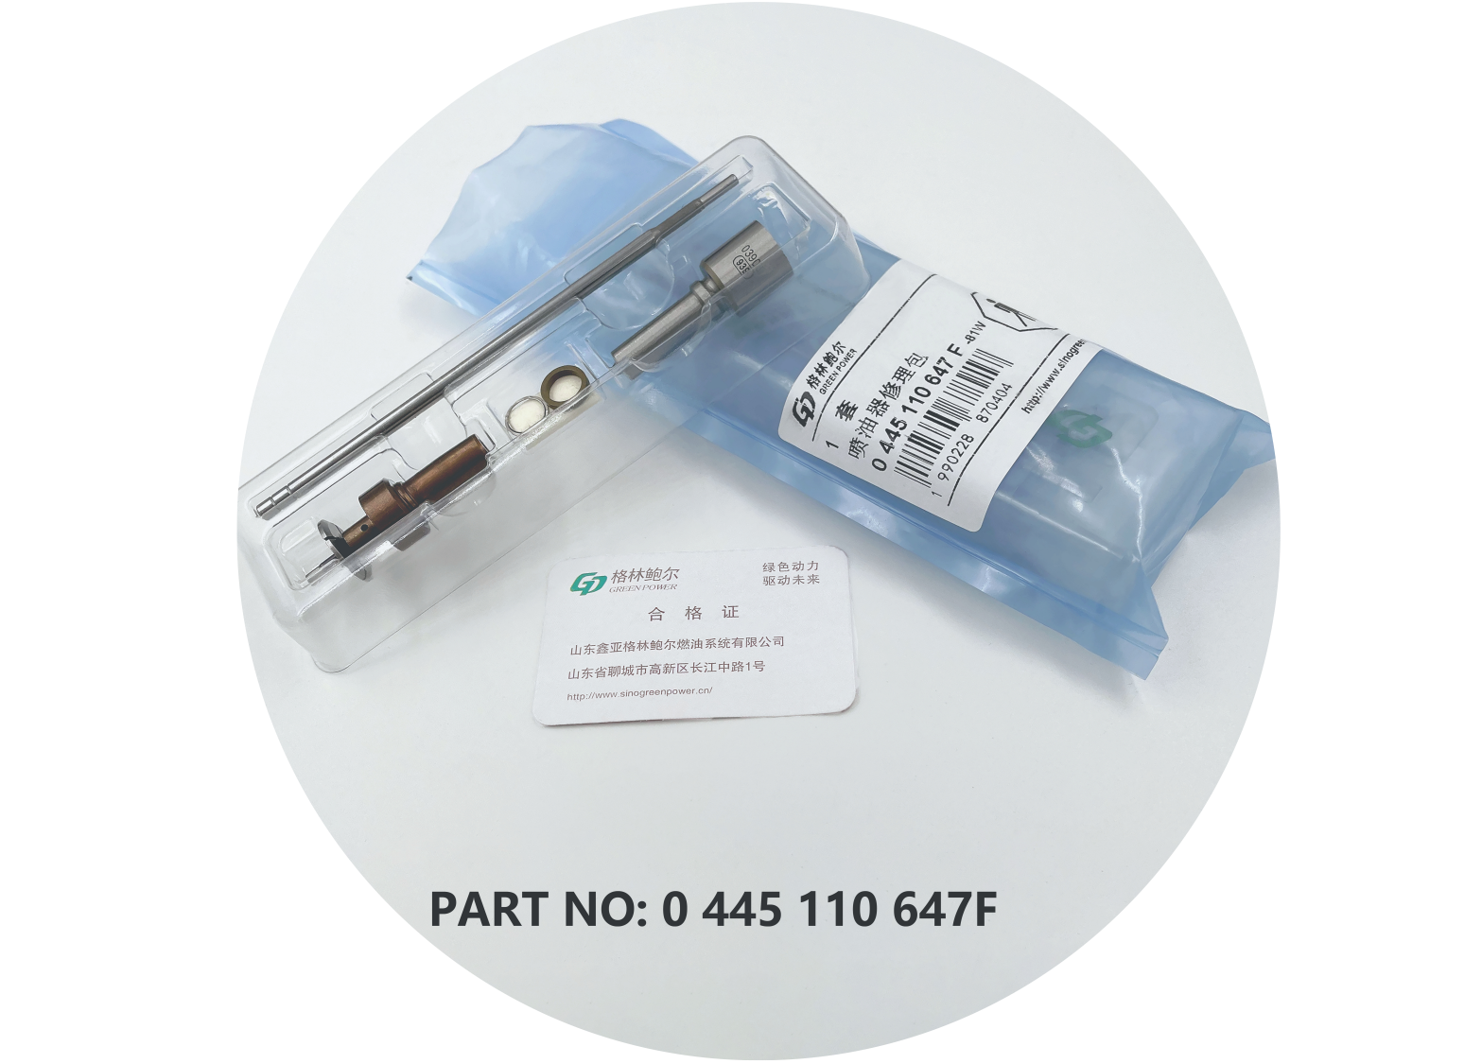
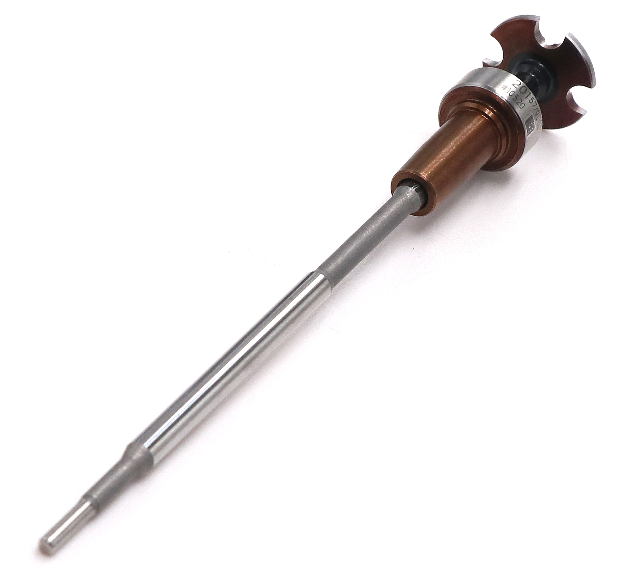
BOSCH SERIES
Bosch injector components best-selling models
F00VC01502
F00VC01200
F00VC01201
0445110647F
F00VC45200
F00VC45201
used for injectors(European V)
F00VC45206
F00VC45204
used for injectors(European V)
0445110368/369/429/437/646/647/688/689
used for injectors(European V)
used for injectors(European V)
0 445 110 646/647
0 445 110 351
0 445 110 418/520
Best-selling markets:
Europe, the United States,
South America, Africa, the Middle East
Best-selling markets:
Europe, North America, South America
Best-selling markets:
Europe, North America, South America
Best-selling markets:
Europe, the United States,
South America, Africa, the Middle East

Slide 15
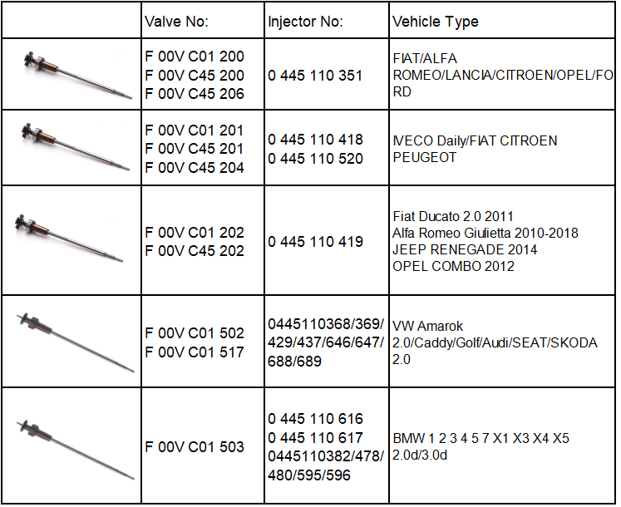
BOSCH SERIES
Green Power currently sells five kinds of valve assemblies (European Ⅴ) , all of which are mainly strategic products.
(European Ⅵ products have not been developed yet.)
Note: All five repair kits are available for purchase.

Slide 16
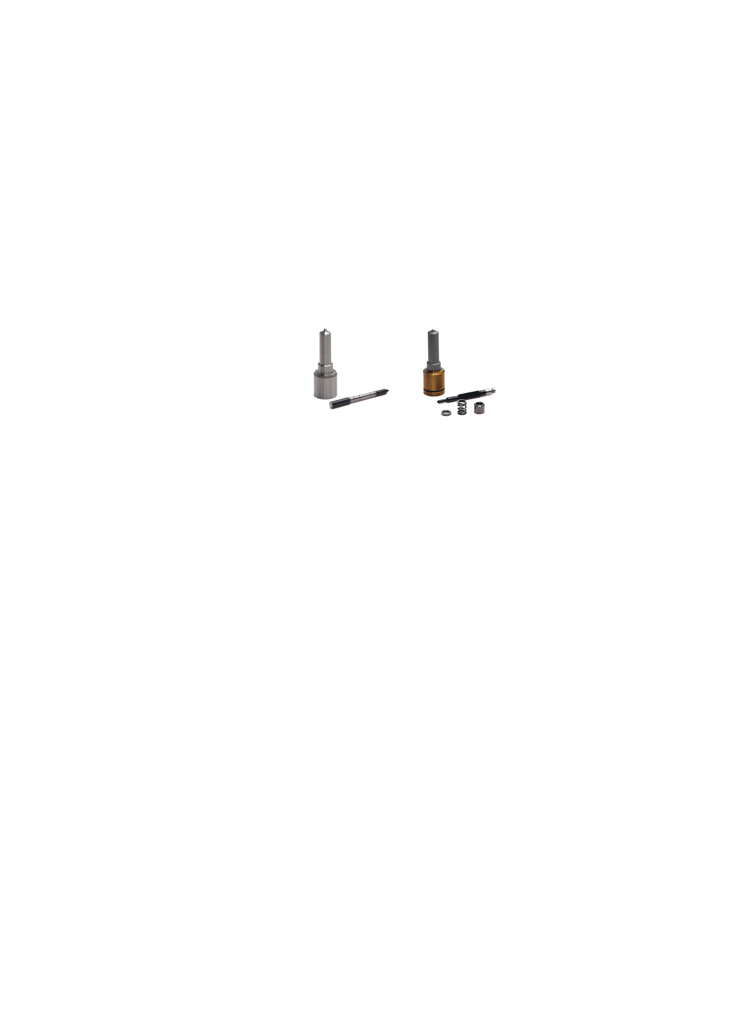
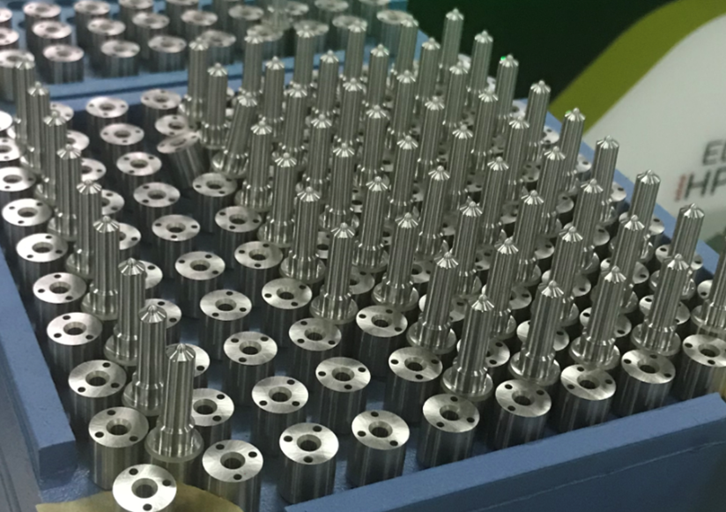
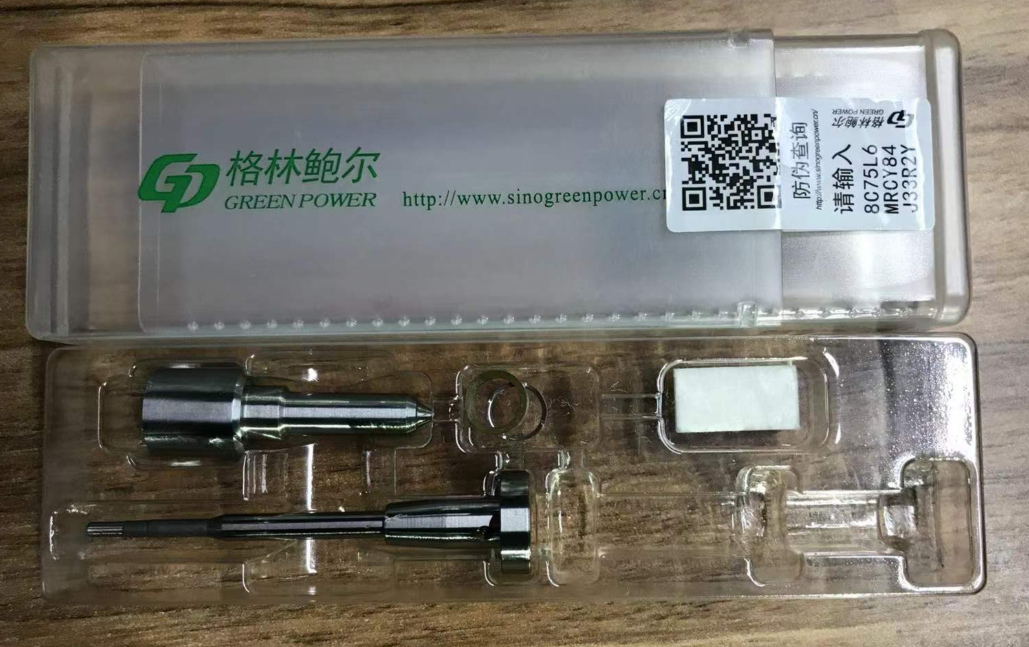
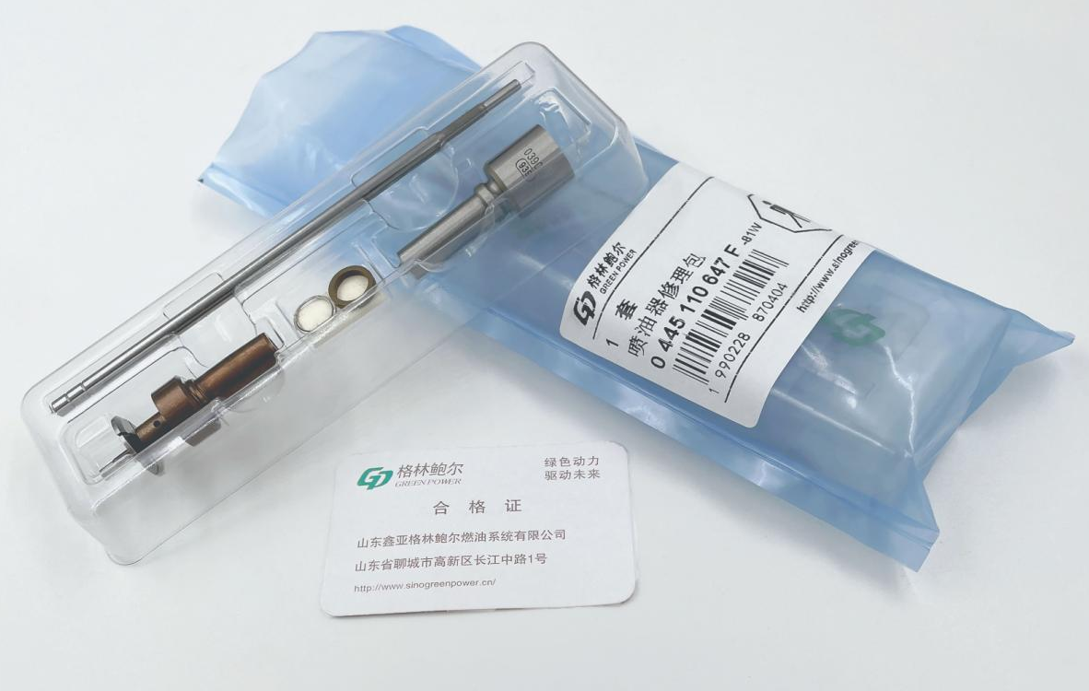
BOSCH SERIES
Bosch Nozzle
Bosch nozzles have two grades: G2 and G3, the latter is more expensive.
Bosch Repair Kit
Aimed at the specific requirements from customers, the company provides three specifications for Bosch repair kits.
Repair kit 110: nozzle*1, valve110*1, nozzle shim*2
repair kit assembly 110: nozzle*1, valve assembly*1, nozzle shim*2, shim*3
Repair kit 120: nozzle*1, valve120*1, nozzle shim*2

Slide 17

DENSO SERIES
· Denso series of main products: high-pressure common rail injector, nozzle, orifice plate and repair kit.
Denso Injectors
Denso injectors are mainly used for the Japanese pick up vehicles, SUV, engineering machinery and American agricultural machinery, they are G2 injectors and G3 injectors by nozzle grade (G4 are now being developed). At present Denso series, top 1 sales, have the largest market among other series.
Based on the original structure of Denso injectors, technical team changes the filter element at the injector inlet into the filter strainer to improve the durability of injectors, which greatly enhances the injector’s own ability to filter impurities.
The test line is in accordance with the original test specifications of Denso to ensure that the test data of all injectors under the power amplifier points are entirely consistent with the original injectors before the factory.
The main market:
The globe, focus on the America and the Middle East

Slide 18




DENSO SERIES
Denso injectors best-selling models
095000-5471
Engineering machinery
095000-5600/1465A041
Passenger vehicles
095000-6480/RE529149
Agricultural machinery
23670-30300/095000-776#
Passenger vehicles
ISUZU
4HK1/6HK1
Best-selling markets:
America, the Middle East, South Africa, Southeast Asia, Eastern Europe
MITSUBISHI L 200
MITSUBISHI Tritton
MITSUBISHI Pajero
Best-selling markets:
Europe, North America, South America
JOHN DEERE
8350
Best-selling markets:
North America
TOYOYA
HIACE 2KD-FTV
Best-selling markets:
America, the Middle East, Southeast Asia, Africa, Europe

Slide 19



DENSO SERIES
Denso Nozzle
Denso nozzles have three grades: G2, G3 and G4. The G2 nozzle number starts with DLLA, the other two start with G3 and G4 respectively. The higher grade is, the closer year of vehicle models is, so its nozzles and injectors are also more expensive.
Denso Valve
Orifice plates are divided into the ordinary orifice plate and G4 orifice plate. The G4 orifice plate is the latest hot product launched by the company in the second half this year.
Denso Repair Kit（The repair kit program is more cost-effective than the purchase of a single product, so it is given priority.)
Aimed at the specific requirements from customers, the company provides four specifications for Denso repair kits. (G4 repair kit will be launched in 2022 )
1.G2 repair kit (no valve stem) : G2 nozzle*1, nozzle nut*1, O-ring*2, nozzle pin*2, orifice plate pin*2, orifice plate*1.
2. G2 repair kit: G2 nozzle*1, nozzle nut*1, O-ring*2, nozzle pin*2, orifice plate pin*2, orifice plate*1, valve stem*1.
3. G3 repair kit (no valve stem) : G3 nozzle*1, nozzle nut*1, O-ring*2, nozzle pin*2, orifice plate pin*2, orifice plate*1.
4. G3 repair kit: G3 nozzle*1, nozzle nut*1, O-ring*2, nozzle pin*2, orifice plate pin*2, orifice plate*1, valve stem*1.
F means the repair kit does not contain the valve stem, and G means the repair kit contains the valve stem in the catalog.

Slide 20


DENSO SERIES
Denso injector components best-selling models
G4S008
Passenger vehicles
G4S009
Passenger vehicles
G4 orifice plate
Passenger vehicles
23670-0L090G
Passenger vehicles
used for injectors:
23670-0E020
TOYOTA 1GD
Best-selling markets:
Southeast Asia, South America, the Middle East
used for injectors:
23670-0E010
TOYOTA 2GD
Best-selling markets:
Southeast Asia, South America, the Middle East
used for injectors:
23670-0E010
23670-0E020
TOYOTA 1GD/2GD
Best-selling markets:
Southeast Asia, South America, the Middle East
used for injectors:
23670-0L090
TOYOTA 1KD HIACE
Best-selling markets:
Southeast Asia, South America, the Middle East

Slide 21
CAT SERIES
· C7 and C9 series injectors are available with all components, 320D and Perkins series injectors only offer components for Green Power structure’s except the control valve.
CAT Injectors
CAT series injectors are all used for CAT engineering machinery, no passenger vehicles: 320D(C6.4), Perkins(C6.6) and C7/C9 series.
In 320D and Perkins series, the new product, pioneered by the Green Power technical team who improves Bosch’s structure to apply to CAT injectors, which promotes the performance and maintenance economy of the injectors. It has been widely praised worldwide since the product came out for more than 4 years.
CAT C7/C9 series of injectors are important R&D achievements of the company for 20 years, its internal structure is exactly the same as the original manufacturer. According to the customers’ demand, the company can provide all of maintenance parts. Green Power, the first domestic independent R&D company, completes all parts of the independent production.
The company released a strategic product in 2021 :CAT 320D control valve——32F61-00062, so as to adapt to the requirements of the original injector’s structure.
The main market:
America (the United States, Brazil), Europe, Africa, the Middle East

Slide 22



CAT SERIES
Contrast of the CAT valve and the Green Power valve
10%
20%
1.Ball valve has much better robustness (facing poor fuel).
2.Ball valve has a much longer service life.
3.Less return fuel makes it easy to fire, especially in winter.
Green Power plans

Slide 23


CAT SERIES
Green Power performance
The test bench tests the main injection, emission, idle speed and pre-injection amount, which are only representative oil amounts in the work of the injector. During the development stage of the injector, we measure tens of thousands of fuel quantities to form a map.
20%

Slide 24

CAT SERIES
Green Power performance
20%

Slide 25



CAT SERIES
CAT injector components best-selling models
32F61-00062
Engineering machinery
326-4700 (Bosch structure)
Engineering machinery
C7/C9
Engineering machinery
used for injectors:
C6.4/C6.6 PERKINS
Best-selling markets:
America, Europe, the Middle East and all of customers using CAT engineering machinery
used for injectors:
CAT 320D C6.4
Best-selling markets:
America, Europe, the Middle East and all of customers using CAT engineering machinery
used for injectors:
CAT 336D
Best-selling markets:
America, Europe, the Middle East and all of customers using CAT engineering machinery

Slide 26

Delphi SERIES
DELPHI SERIES
Delphi Valves
Delphi series currently offer two injector control valves —— 7135-588 and 625C.
7135-588 is recommended the main product as the first new part on account of the short supply for the original and its huge market demand.
The pump nozzle assembly is currently under development and is expected to be lunched in the second half of 2021 to the first half of 2022.
The main market:
Europe, America, Brazil, the Middle East

Slide 27
The quality of the parts
Green Power
injector assembly
armature group assembly
Data feedback about more than 10,000 injector assemblies every month
injector
customer
Test each piece per day
valve assembly
Collect customers’ information in time
nozzle
other manufacturers
valve assembly
customer
nozzle

Slide 28


THANK YOU
Notes:
更多模板下载地址：http://www.pptvzaixian.com/shop/view28111.html（复制链接到浏览器打开）

